Slide 1
Introduction to Docker: Streamlining Your Software Development Process
Elliot Mason
Notes:
Hello everyone, welcome to our seminar today, 'Introduction to Docker: Streamlining Your Software Development Process'. My name is [Your Name] and I'm thrilled to be here with you all. This session is designed to help you understand what Docker is, and how it can enhance and streamline your software development process.

Slide 2
Agenda
Why is Docker Needed?
VMs vs. Docker Containers: A Comparison
An Introduction to Docker: Key Concepts and Terminology
The Docker Workflow: How Docker Works?
Benefits of Docker in Software Development
Hands-on: Basic Docker Commands
Use Cases of Docker
Conclusion and Q&A
Notes:
Let's quickly go over our agenda for today:
We'll start by understanding the age-old problem of software development and deployment that necessitated the development of Docker.
Next, we'll dive into a comparison between Virtual Machines and Docker Containers, two major technologies that have changed the landscape of application deployment.
We'll then introduce Docker, its key concepts, and terminology, to ensure everyone has a solid foundation.
We'll discuss the Docker workflow and see how Docker actually works.
After understanding Docker, we'll move to why Docker is so important for software developers and the benefits it brings.
Then, we'll get our hands dirty with some basic Docker commands.
We'll discuss various use cases where Docker can be applied.
Finally, we'll wrap up the seminar with a conclusion and a Q&A session, where I welcome your thoughts and any questions you may have."

Slide 3
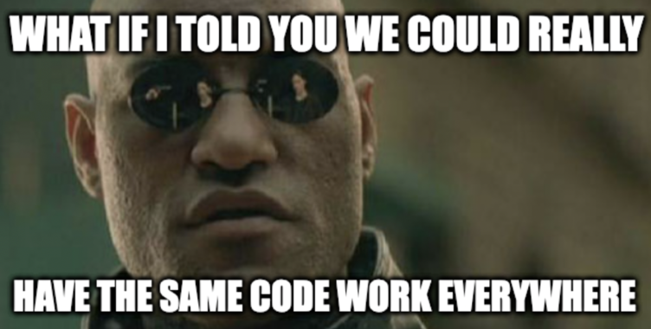
Notes:
Software development and deployment come with their own set of challenges. For a long time, developers and organizations have been wrestling with problems like environment inconsistencies, the time-consuming setup of development environments, and scalability issues. Has anyone here ever heard the phrase 'But it works on my machine?' Well, it represents a common problem in software development.
[DEV ENV STORY]
Welcome to the very first problem Docker aims to solve - environment inconsistencies. Different development, testing, and production environments can lead to inconsistent behavior of your applications. Even the slightest variations in OS, system libraries, or supporting software versions can cause an application to behave unexpectedly.“
[LEAD INTO DOCKER INTRO]

Slide 4
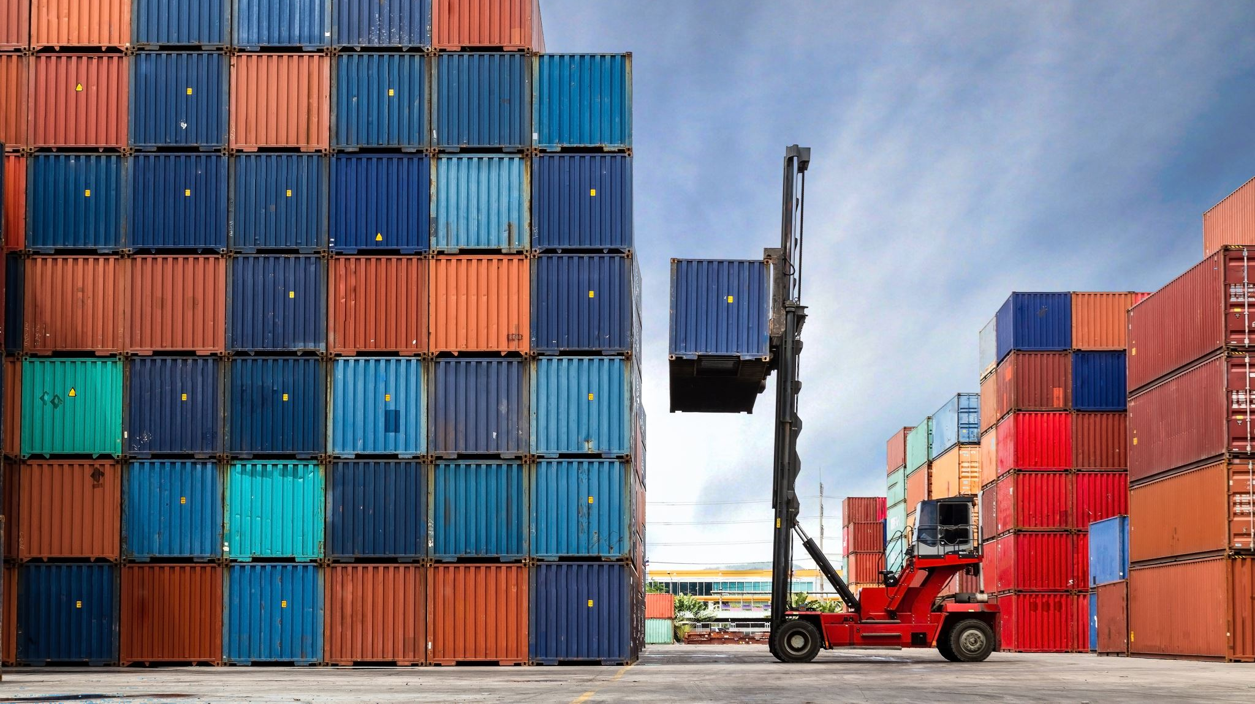
ENTER DOCKER
Notes:
To tackle these challenges, Docker was introduced. Docker is a platform that makes it easier to create, deploy, and run applications by using containers. But what is a container?
This magic box could capture the exact environment in which Sam's code runs perfectly, including all the system settings, libraries, and dependencies. And guess what? Sam could then carry this magic box anywhere - to a testing environment, a staging environment, or a production server. The code would still run perfectly, just as it did on Sam's local machine.
[[JOKE]] – [[HERE IS WHERE YOU WANT TO CHIME IN BUT THAT’S JUST A VM]]
[[LEAD TO VM VS DOCKER]]

Slide 5
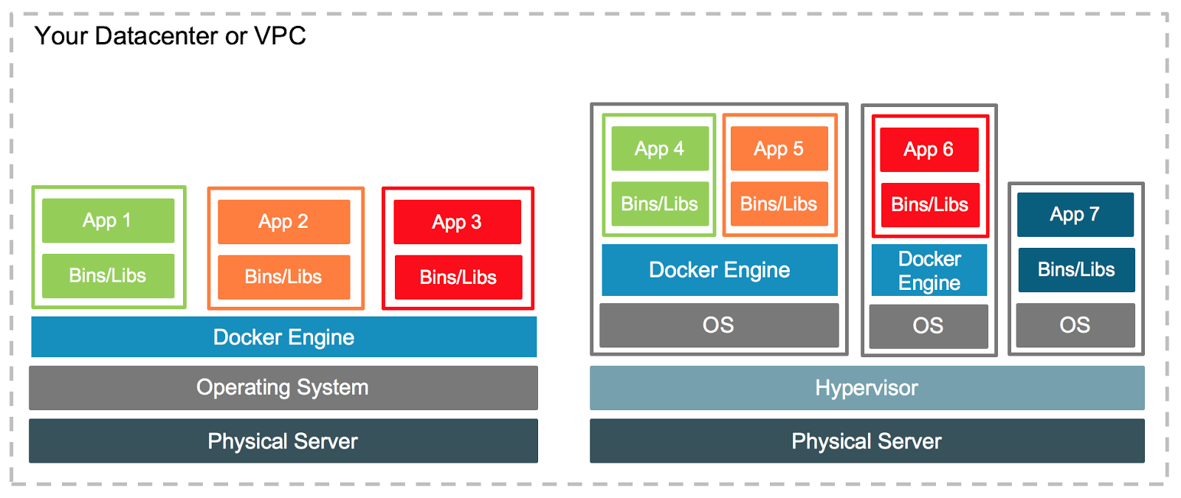
VM vs Docker
Notes:
A Virtual Machine is like a computer within a computer. It runs on a physical computer, called the host, but it acts like a separate computer, called the guest. Each VM has its own operating system, its own software, and its own resources. It's like renting an entire apartment for yourself. You have all the space, but you're also responsible for all the maintenance
On the other hand, Docker Containers, are lightweight alternatives to VMs. Think of containers like sharing an apartment with friends. Each one of you has your own room (which can be thought of as your application and its dependencies), but you all share the common areas like the kitchen and living room (which are the OS and the underlying infrastructure).
Containers share the host system’s OS kernel and don't require an OS per application, which makes them more lightweight. They encapsulate the application's software environment, ensuring it runs uniformly across different platforms

Slide 6
When to Docker or VM?
Notes:
"So, when should we use VMs and when should we use Docker?
Virtual Machines are excellent for running applications that require all of the operating system's resources and functionality when you need to run multiple applications that are not necessarily on the same operating system, or when you have apps that need to leverage hardware virtualization.
Docker is a better choice when your applications are built as microservices or when you need to deploy multiple instances of your application on a single machine.
For example, if you're developing a large-scale application that involves several components each running on a different operating system, VMs might be the way to go.
On the other hand, if you're developing an application using microservices, where you need to rapidly scale up or down, Docker containers would be a more efficient choice due to their lightweight nature and faster start-up time."
"But remember, these are not hard and fast rules. The choice between VMs and Docker often depends on your specific use case, resources, and the architecture of your application."

Slide 7
Docker Terminology
Docker Images
Docker Engine
Docker Daemon
Docker Client
Docker Registers
Notes:
[[-DOCKER IMAGES-]]
First up, we have 'Docker Images'. Now, I'm not talking about beautiful landscape photos or artistic portraits here. A Docker image is a lightweight, standalone, executable package that includes everything needed to run a piece of software. It's like a recipe with a list of ingredients and instructions to make your favorite dish - your software application.“
[[=DATA SENSITIVITY=]]
Before we move on, let's talk about something a bit serious - cloud-based data storage. Now, we all love our clouds, right? They're accessible from anywhere, easy to use, and quite handy for storing and sharing files. But, when you're at work, things can get a bit...cloudy.
Keep in mind that any data you store in a cloud-based system may leave your organization's network. This includes Docker Registries, which we just talked about. In a world where data privacy and security are more important than ever, it's crucial to ensure that you're not unknowingly sharing sensitive information.

Slide 8
Example Y2K API Workflow

Slide 9
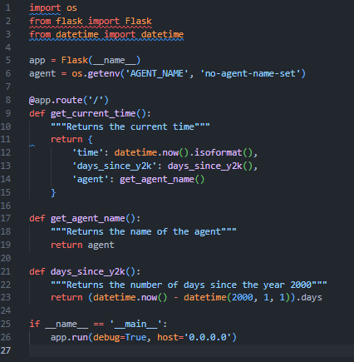

How many days since Y2K?
Basic Python Flask Application
Single response at root of app
Returns agent name, current date, and days since Y2K
Notes:
Y2K: 8569 as of 6/20/23

Slide 10
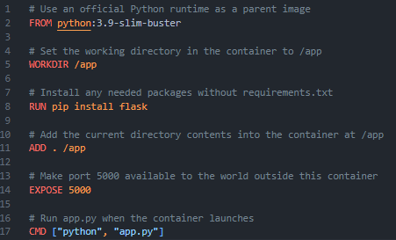
Dockerfile
Order Dockefile instructions carefully
Use .dockerignore file
Avoid installing unnecessary packages
Notes:
Docker utilizes a layering system for Docker images, which can significantly improve build times and image storage if used correctly. Each instruction in a Dockerfile creates a new layer in the image, and Docker uses a caching mechanism that only rebuilds layers of the image that have changed since the last build.
Order your Dockerfile instructions carefully: Dockerfile instructions should be ordered from least frequently changed to most frequently changed. This way, when you modify your application's source code, Docker can reuse the cached layers for installing dependencies and other setup tasks, and only the layers for the source code need to be rebuilt.
Combine RUN instructions when possible: Each Dockerfile instruction creates a new layer, and layers take up space. To minimize the number of layers, you can chain RUN instructions using &&, but do so judiciously to maintain readability.
Use .dockerignore file: Much like .gitignore, you can use a .dockerignore file to prevent your local modules and debug logs from being copied onto your Docker image and possibly overwriting modules installed within your image.
Avoid installing unnecessary packages: Only install the necessary packages that your application needs to run. Each additional package increases the build time and the size of the image.
Use multi-stage builds: If your application requires a build system or includes extra tools in the image that are not needed to run the application, consider using a multi-stage build. This allows you to have a "build" stage where you compile your application, and a "production" stage where you copy only the built application from the build stage, resulting in a smaller final image.

Slide 11
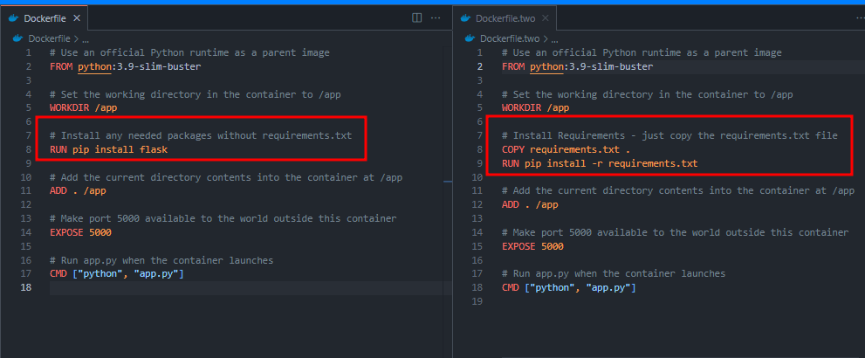
Installing Requirements
Notes:
Note the two ways that we can install dependencies. In this case, this is pip and Python, but for example with node you would copy over your package.json and then run the NPM install and whatever else you need to do
NOTE AGAIN: Ability to combine commands with && to make that image layer a cached layer leading to quicker subsequent builds.

Slide 12
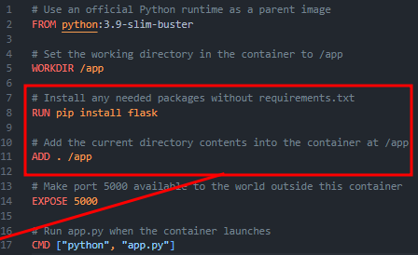
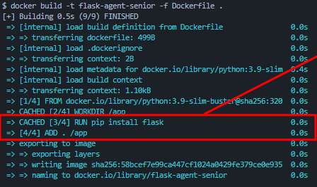
Order of Operations when Dockerfile-ing
Notes:
[[ORDERED FROM LEAST FREQUENTLY CHANGED TO MOST FREQUENTLY CHANGED]]
Dockerfile instructions should be ordered from least frequently changed to most frequently changed. This way, when you modify your application's source code, Docker can reuse the cached layers for installing dependencies and other setup tasks, and only the layers for the source code need to be rebuilt.

Slide 13
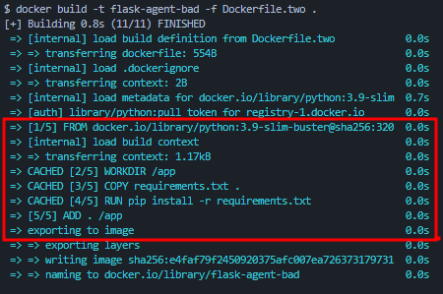
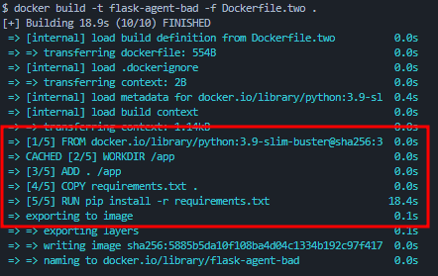
Breaking install before source copy
Least to Most
Most to Least

Slide 14
What if we are trying to serve millions of requests with our Y2K flask container??
Baby intro to container orchestration concepts and basic implementation

Slide 15
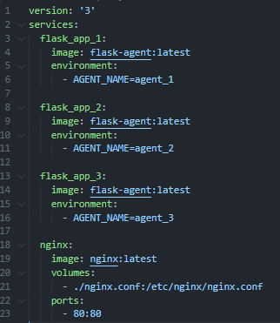
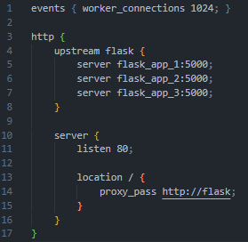

Notes:
Note the docker compose file
The nginx config file
And the part where were are getting the name of the agent from the environment variables
---
Segway to demo on laptop
---

